Slide 1

INTRODUCTION
EASY
ADVANCED

Slide 2

INTRODUCTION
In this project, we will learn how to define and invoke lambda functions using AWS Boto3 SDK.
Lambda is the most popular and used service in AWS.
AWS lambda free developers from the worry of provisioning resources, specifying operating systems, managing Hardware, and performing maintenance.
Simply write your code and run it on Lambda!
Define a Lambda function using Boto3 SDK.
Test the lambda function using Eventbridge (cloudwatch events).
Understand the difference between synchronous and asynchronous invocations.
Invoke a Lambda function using Boto3 SDK.

Slide 3
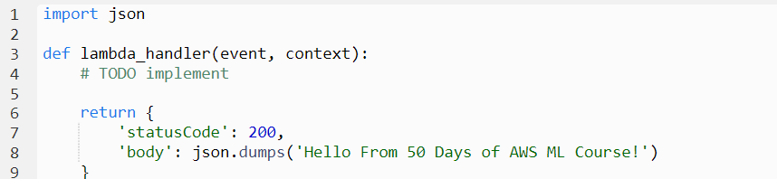
AWS LAMBDA FUNCTION ANATOMY (RECAP)
Handler() Function: Function to be executed upon invocation and it requires two arguments “event” and “context”.
Event Object: data sent during lambda function invocation, for example if a request is made from S3, the event object will contain the bucket key and what kind of action has been performed on the bucket.
Context object: this is generated by the platform and contains information about the underlying infrastructure and execution environment such as allowed runtime and memory.

Slide 4
SYNCHRONOUS Vs. ASYNCHRONOUS INCOVATIONS
EASY
ADVANCED

Slide 5
SYNCHRONOUS Vs. ASYNCHRONOUS
Lambda functions could be invoked (called) using the Console, AWS SDK, Lambda API and AWS Command Line Interface (AWS CLI).
There are generally two ways of invoking a lambda function: Synchronously and Asynchronously.
Lambda functions invocation documentation: https://docs.aws.amazon.com/lambda/latest/dg/lambda-invocation.html
Synchronous Invocation
With synchronous invocation, you wait for the function to process the event and return a response.
Asynchronous Invocation
With asynchronous invocation, Lambda queues the event for processing, so you don’t have to wait for a response from Lambda.
Synchronous invocations are best suited for Machine Learning workflows.
For asynchronous invocation, Lambda handles retries and can send invocation records to a destination.

Slide 6
DEMO: DEFINE AN AWS LAMBDA FUNCTION USING BOTO3 SDK
EASY
ADVANCED

Slide 7
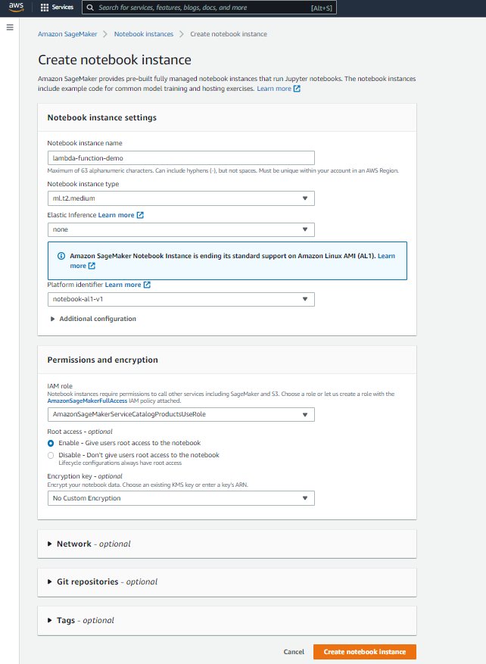
DEMO: CREATE AN AWS LAMBDA FUNCTION USING BOTO3
CREATE A NOTEBOOK INSTANCE

Slide 8
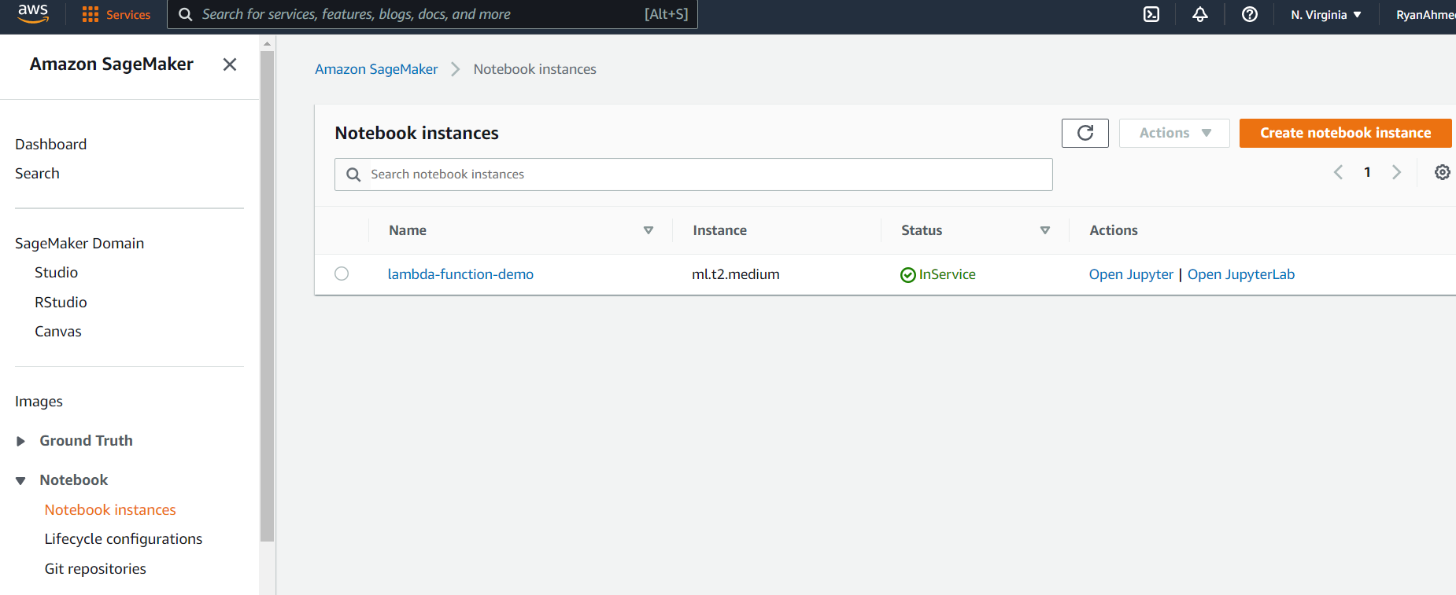
DEMO: CREATE AN AWS LAMBDA FUNCTION USING BOTO3
CLICK ON OPEN JUPYTER

Slide 9
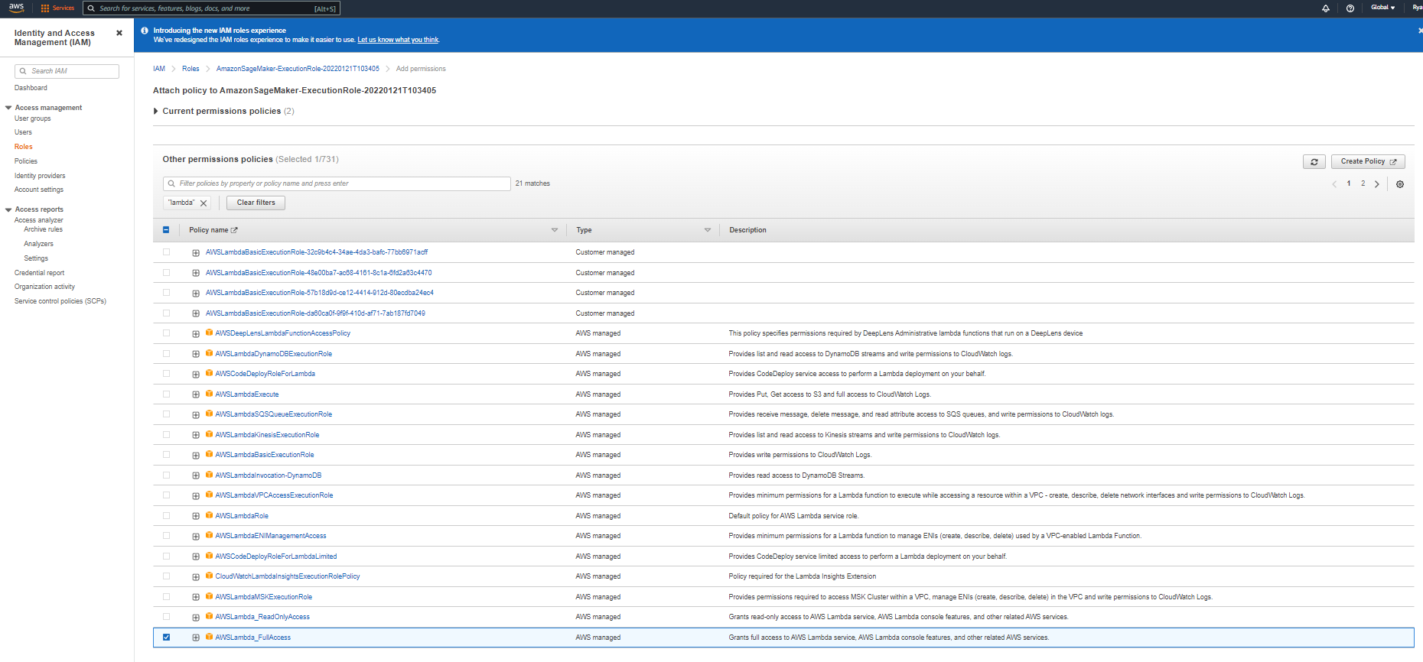
DEMO: CREATE AN AWS LAMBDA FUNCTION USING BOTO3
GO TO THE SAGEMAKER EXECUTION ROLE AND ATTACH “AWSLAMBDA_FULLACCESS” POLICY

Slide 10
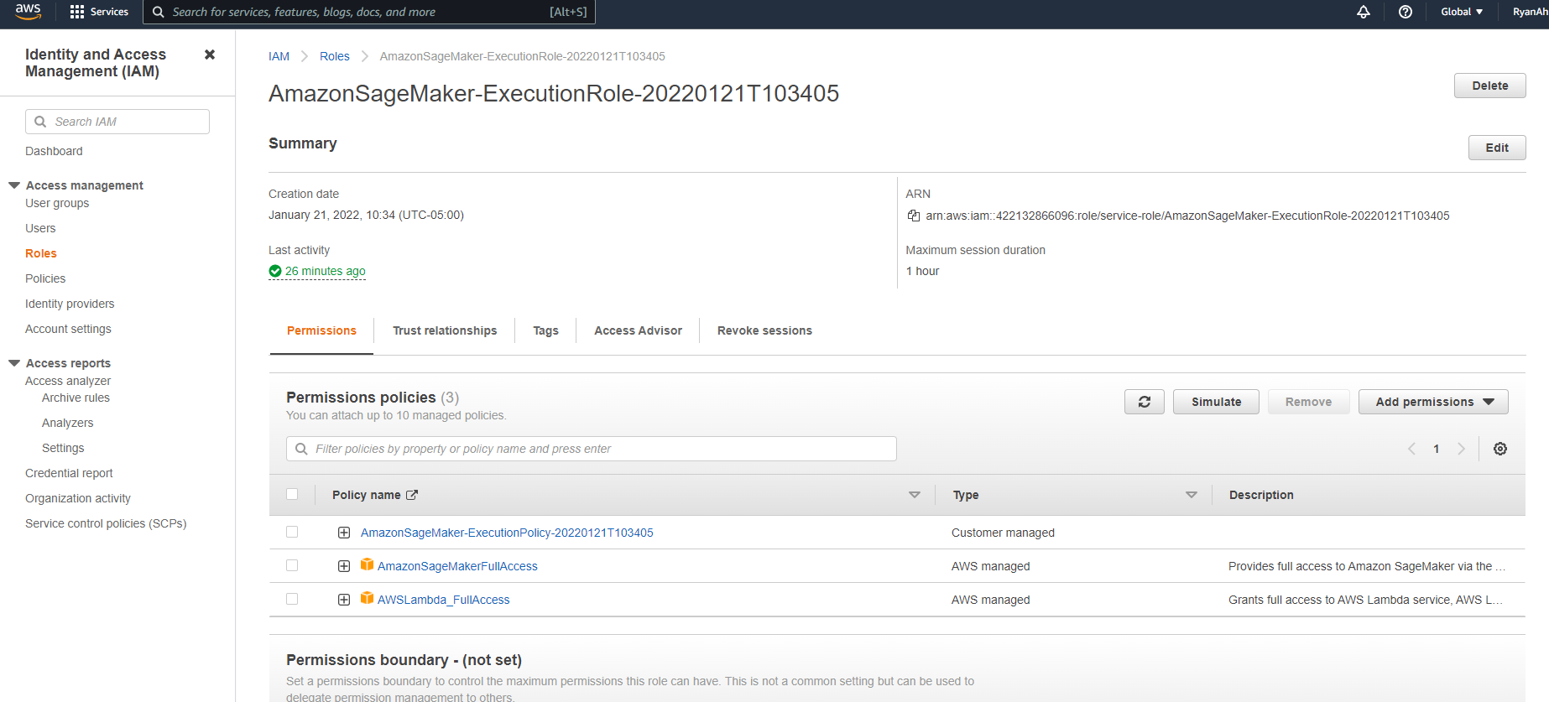
DEMO: CREATE AN AWS LAMBDA FUNCTION USING BOTO3
NOW WE HAVE FULL ACCESS TO LAMBDA!

Slide 11
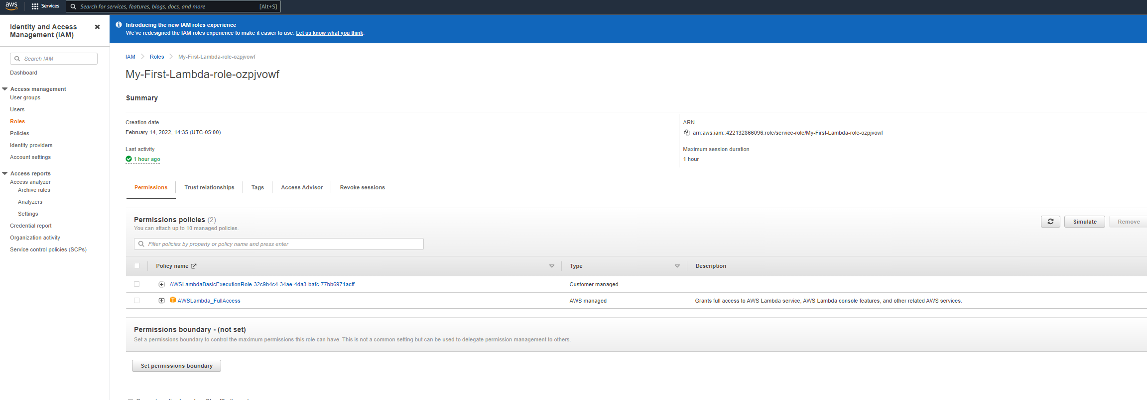
DEMO: CREATE AN AWS LAMBDA FUNCTION USING BOTO3
THIS IS THE ROLE ARN YOU WILL NEED IN CODE

Slide 12
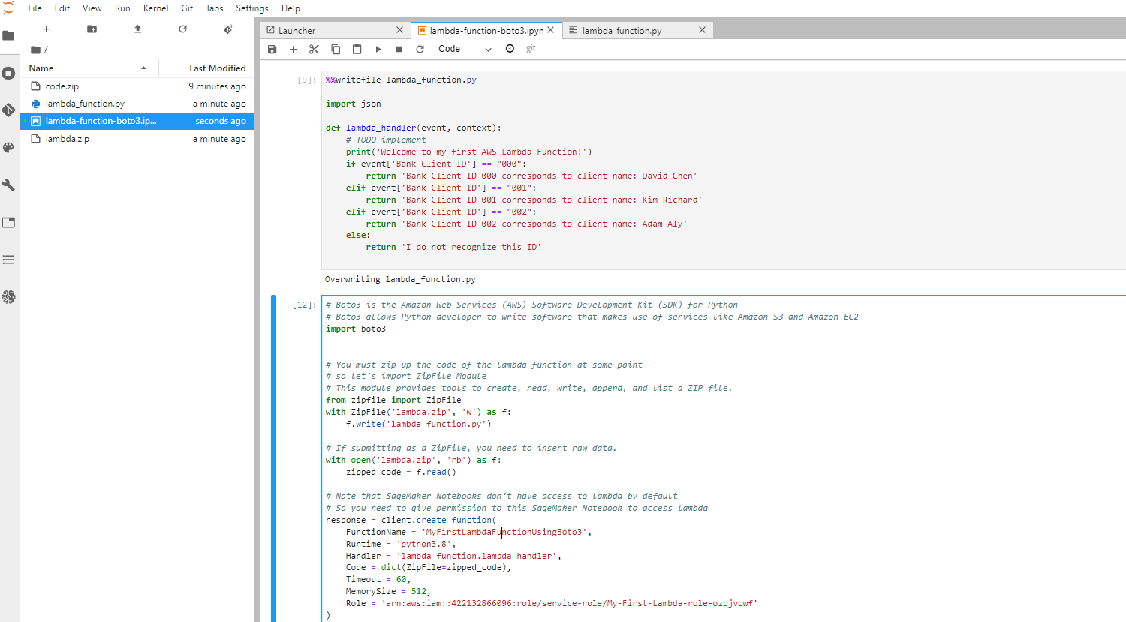
DEMO: CREATE AN AWS LAMBDA FUNCTION USING BOTO3
RUN THIS CODE, YOU SHOULD SEE A NEWLY CREATED LAMBDA FUNCTION ENTITLED “MyFirstLambdaFunctionUsingBoto3” AVAILABLE.
Note: %%writefile lets you output code developed in a Notebook to a Python module

Slide 13
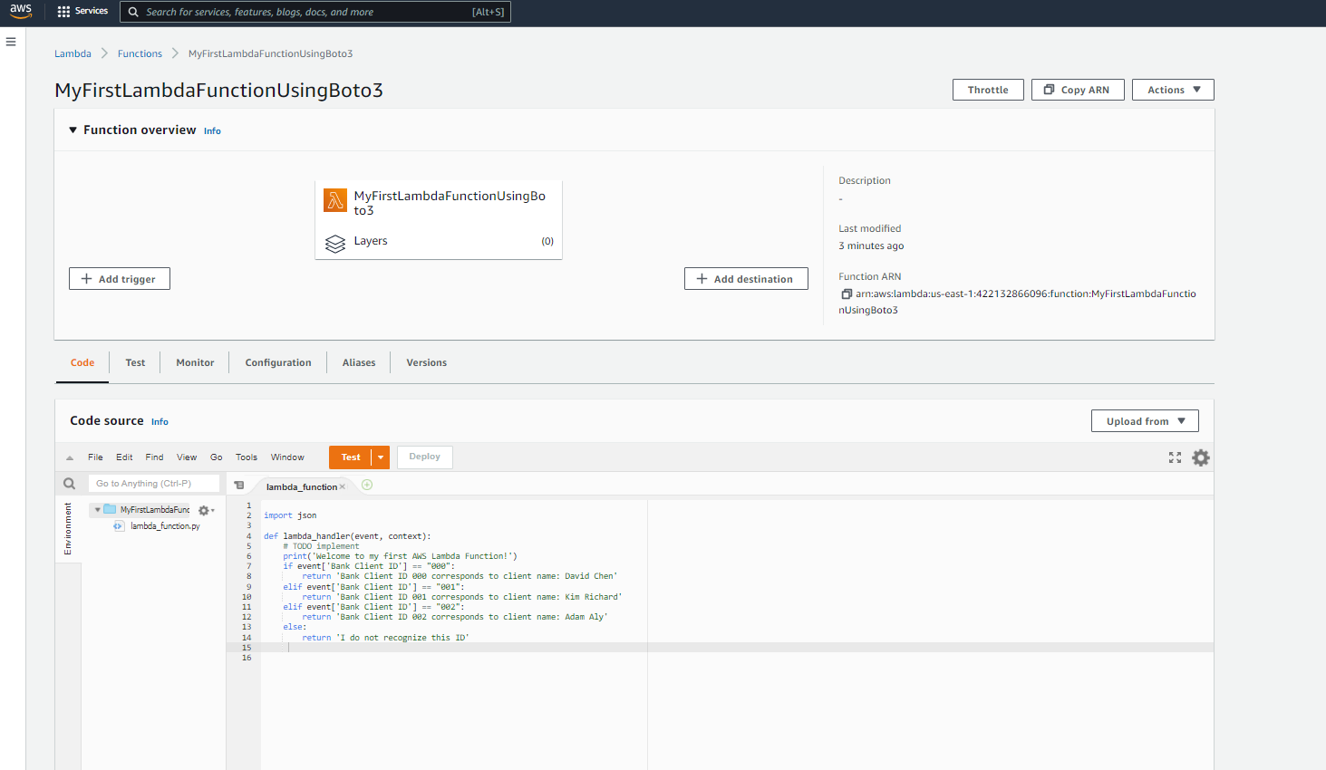
DEMO: CREATE AN AWS LAMBDA FUNCTION USING BOTO3
A NEW LAMBDA FUNCTION ENTITLED “MyFirstLambdaFunctionUsingBoto3” HAS BEEN CREATED USING BOTO3 SDK

Slide 14
DEMO: LAMBDA INVOCATION WITH BOTO3 SDK
EASY
ADVANCED

Slide 15
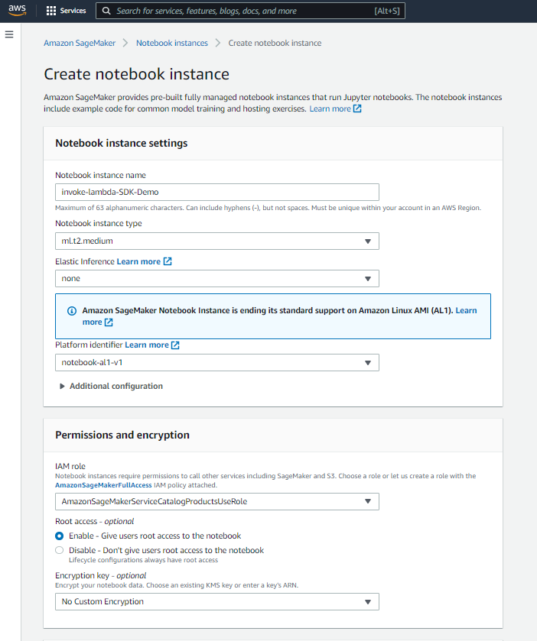
DEMO: LAMBDA INVOCATION WITH SDK
Great Boto3 Documentation: https://boto3.amazonaws.com/v1/documentation/api/latest/reference/services/lambda.html#Lambda.Client.invoke
GO TO SAGEMAKER AND START A NEW NOTEBOOK

Slide 16
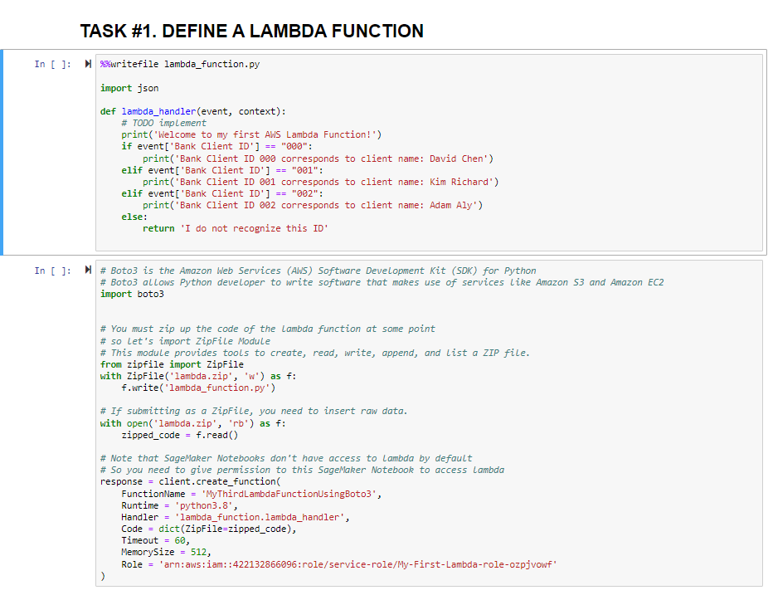
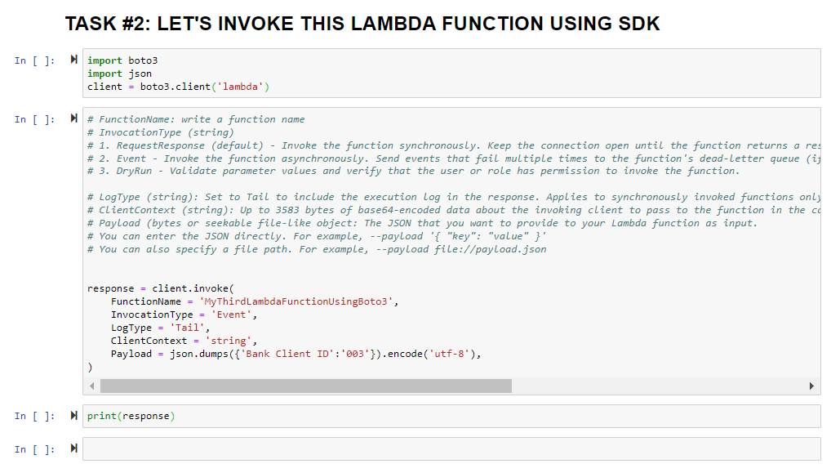
DEMO: LAMBDA INVOCATION WITH SDK
LET’s DEFINE A NEW FUNCTION AND THEN INVOKE IT IN THE SDK

Slide 17
DEMO: LAMBDA INVOCATION WITH SDK
FunctionName: write a function name
InvocationType (string)
1. RequestResponse (default): Invoke the function synchronously.
2. Event: Invoke the function asynchronously.
3. DryRun: Validate parameter values and verify that the user or role has permission to invoke the function.
LogType (string): Set to Tail to include the execution log in the response. Applies to synchronously invoked functions only.
ClientContext (string): Up to 3583 bytes of base64-encoded data about the invoking client to pass to the function in the context object.
Payload: The JSON that you want to provide to your Lambda function as input.
You can enter the JSON directly. For example, --payload '{ "key": "value" }'
You can also specify a file path. For example, --payload file://payload.json

Slide 18
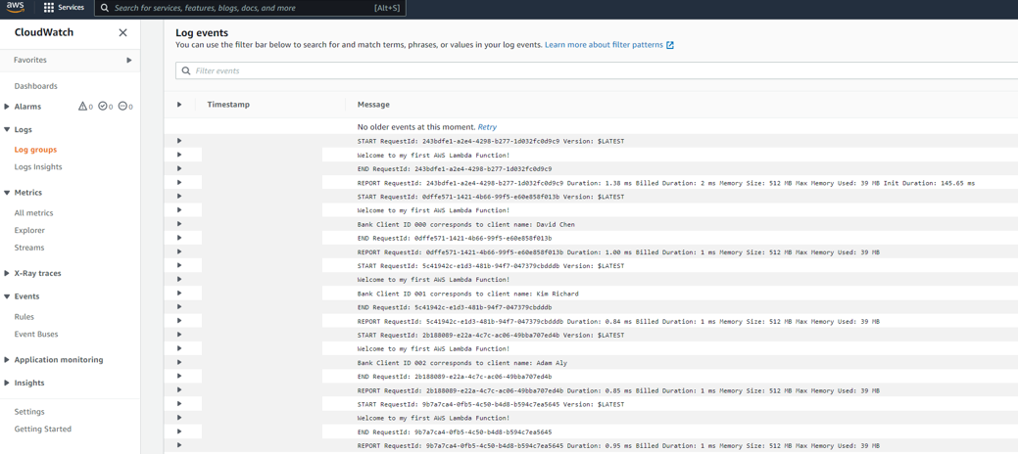
DEMO: LAMBDA INVOCATION WITH SDK
GO TO CLOUDWATCH AND EXPLORE THE LOGS

Slide 19
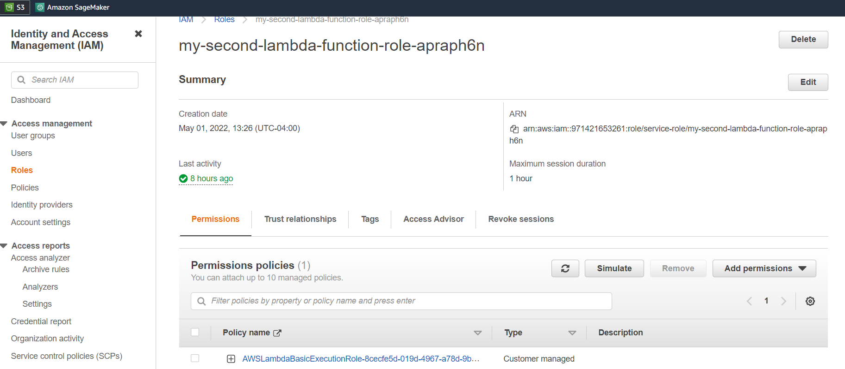
DEMO: LAMBDA INVOCATION WITH SDK
NOTE THAT YOU MIGHT NEED TO ATTACH CLOUDWATCH FULL ACCESS POLICY TO YOUR LAMBDA FUNCTION ROLE TO SEE THE LOGS

Slide 20
DEMO: LAMBDA INVOCATION WITH EVENTBRIDGE
EASY
ADVANCED

Slide 21
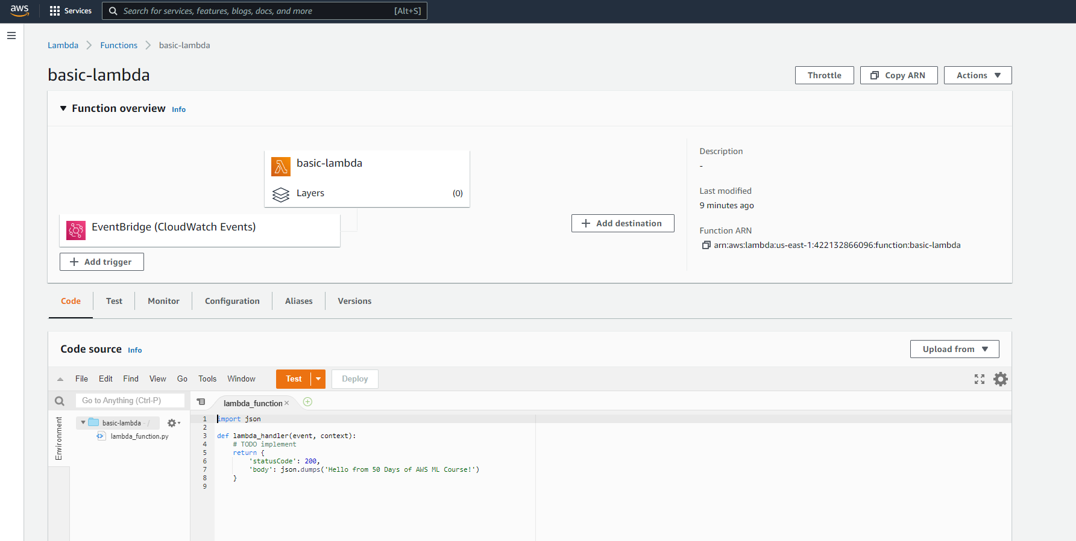
DEMO: LAMBDA INVOCATION WITH EVENTBRIDGE
CREATE A BASIC LAMBDA FUNCTION NAMED “basic-lambda”

Slide 22
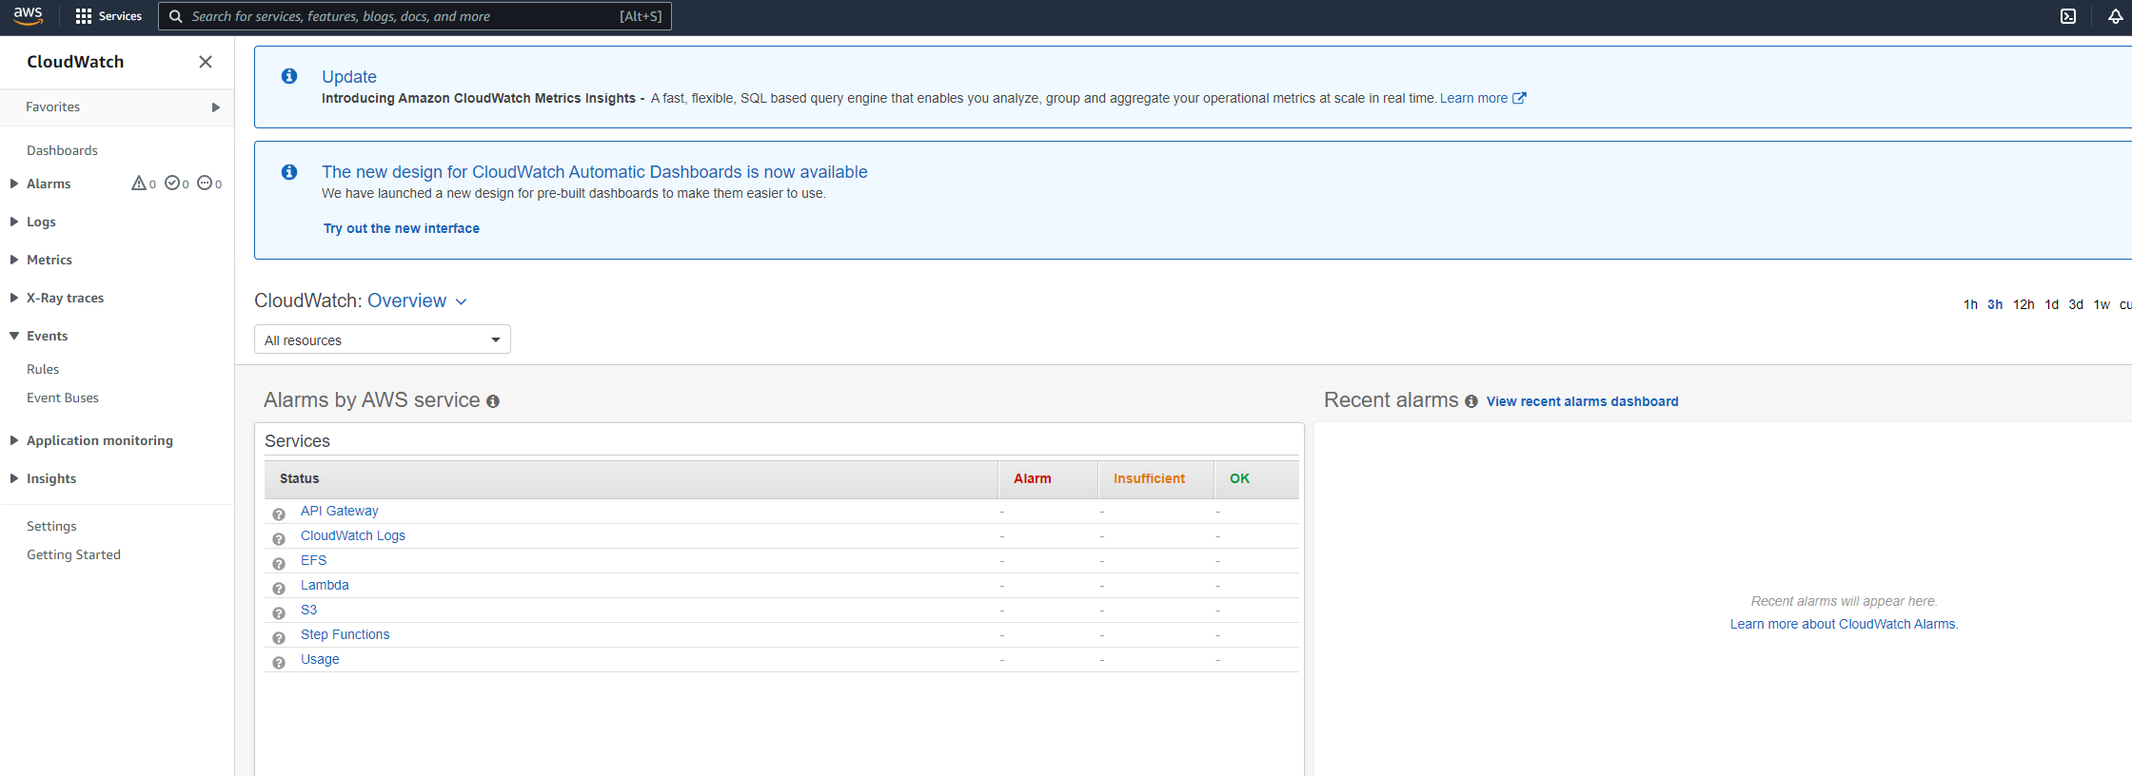
DEMO: LAMBDA INVOCATION WITH EVENTBRIDGE
GO TO CLOUDWATCH AND CLICK RULES

Slide 23
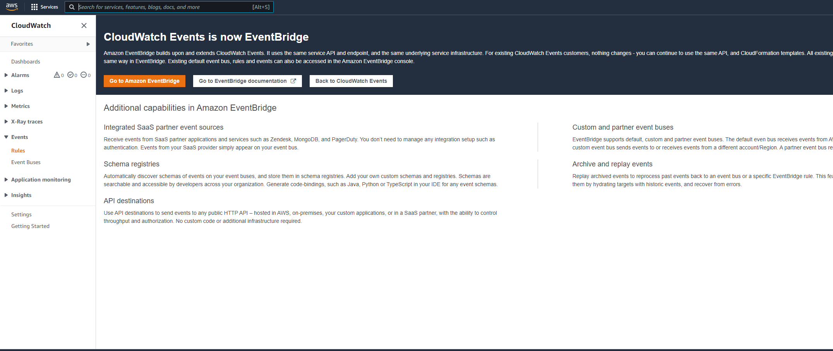
DEMO: LAMBDA INVOCATION WITH EVENTBRIDGE
CLOUDWATCH EVENT IS NOW CALLED EVENTBRIDGE, CLICK ON GO TO AMAZON EVENTBRIDGE

Slide 24
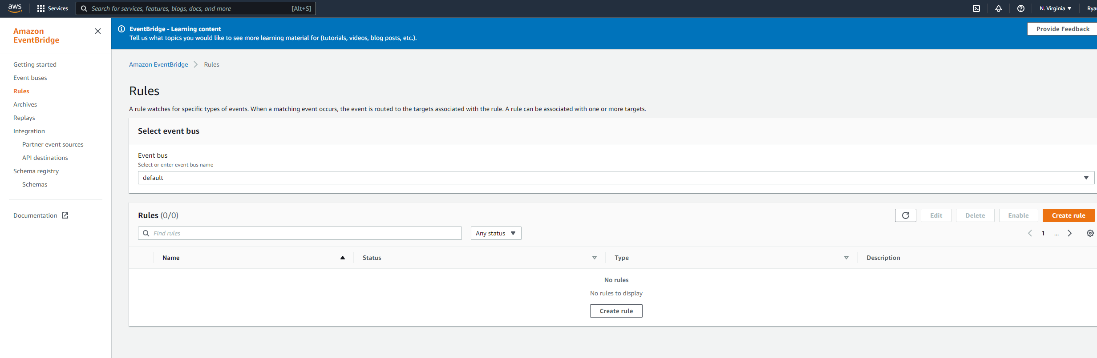
DEMO: LAMBDA INVOCATION WITH EVENTBRIDGE
CLICK ON CREATE RULE

Slide 25
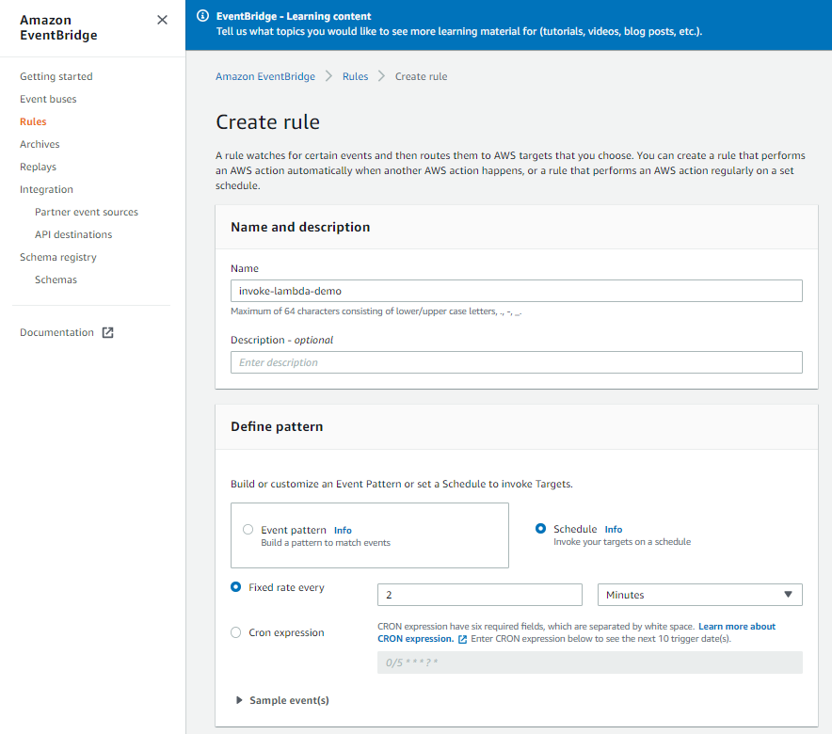
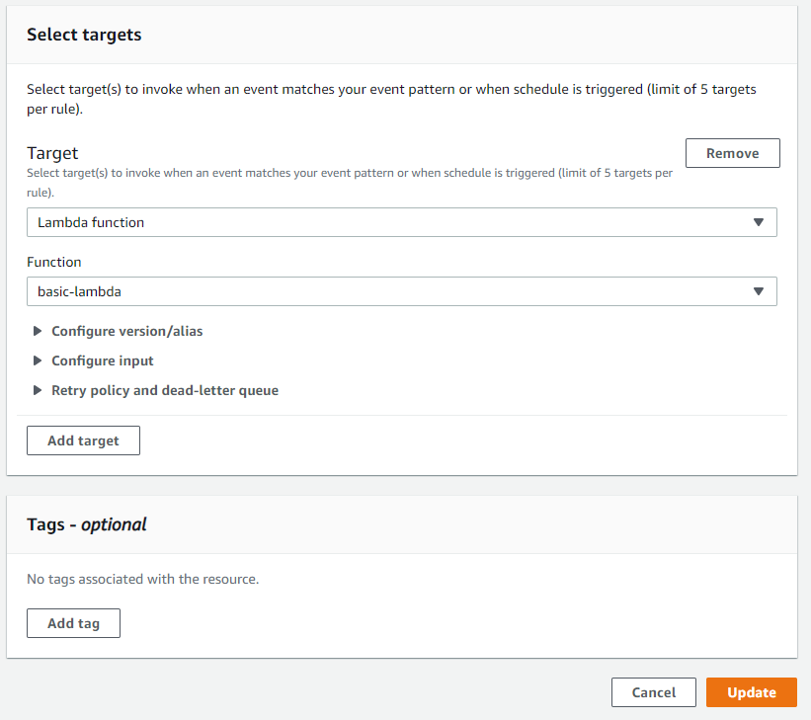
DEMO: LAMBDA INVOCATION WITH EVENTBRIDGE
LET’S INVOKE THE LAMBDA FUNCTION ONCE EVERY 2 MINUTES

Slide 26
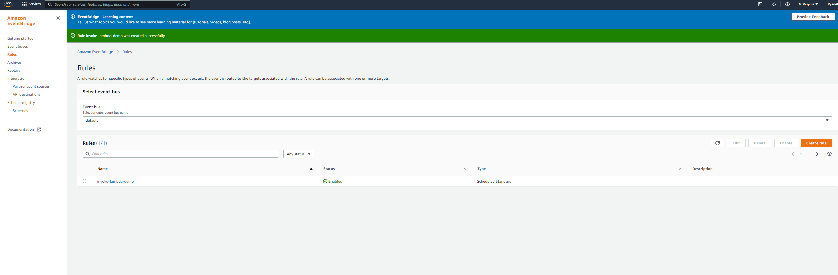
DEMO: LAMBDA INVOCATION WITH EVENTBRIDGE
NOW THE RULE HAS BEEN ACTIVATED, LET’S SEE IF IT WORKS!

Slide 27
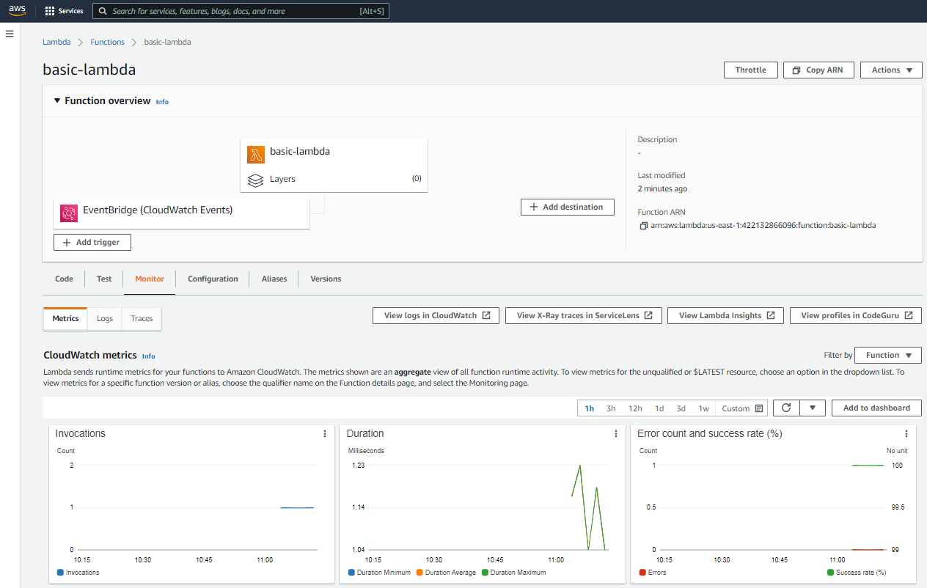
DEMO: LAMBDA INVOCATION WITH EVENTBRIDGE
GO BACK TO THE LAMBDA FUNCTION AND CLICK ON MONITOR

Slide 28
FINAL END-OF-DAY CAPSTONE PROJECT
EASY
ADVANCED

Slide 29
FINAL CAPSTONE PROJECT
Using boto3 SDK, define a Lambda Function named “FundsCalculator” that takes in the number of stock units and stock price and calculates the total value of the portfolio.
Develop a script that consumes the total number of stocks and price of stocks from users.
Return the total value of the portfolio.
Configure the following test events using AWS Boto3 SDK:
Monitor the logs in CloudWatch and ensure that the Lambda Function execution was successful.
Stock Units = 20, stock value = $1000
Stock Units = 5, stock value = $2000

Slide 30
FINAL END-OF-DAY CAPSTONE PROJECT SOLUTION
EASY
ADVANCED

Slide 31
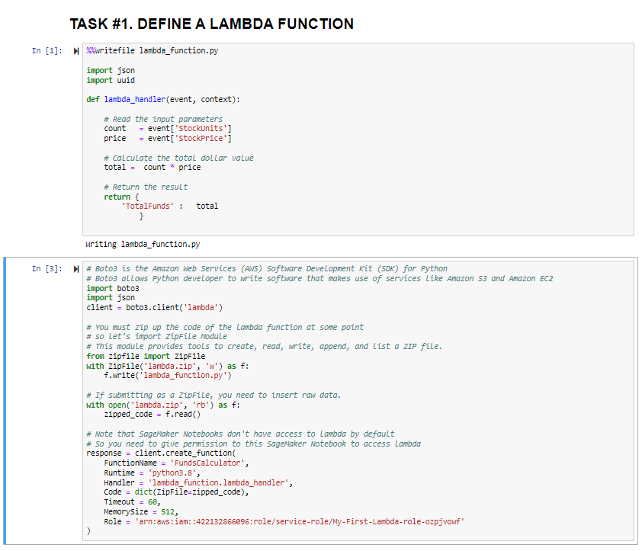
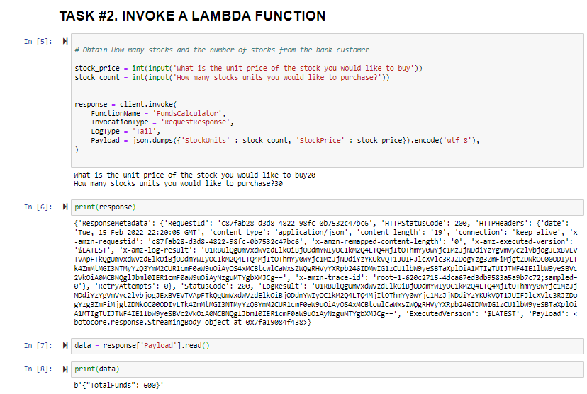
DEMO: LAMBDA INVOCATION WITH SDK

